Slide 1
Save Time, Boost Scores
Practical Guidance for Health Professions Educators

Slide 2
Today’s Speaker
Adonis Wazir
Medical Doctor, East Surrey Hospital, United Kingdom
MSc Medical Education candidate, Swansea University Medical School
Medical Education Consultant, Lecturio

Slide 3
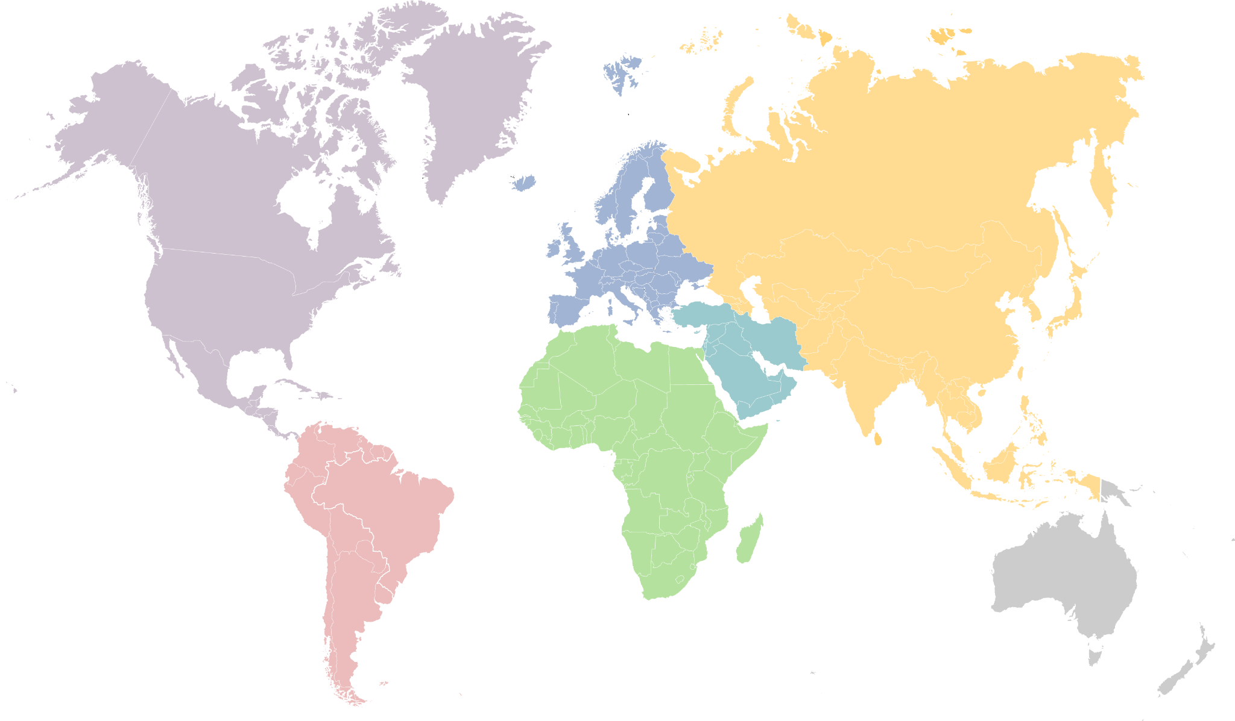
Asia
35+ universities
North America
50+ universities
Europe
20+ universities
Africa
25+ universities
Middle East
5+ universities
South America
15+ universities

Slide 4
Today’s Agenda
1
Introduction to Lecturio
Instructional Design: What is it and why do you need to know about it?
Time Savings with Lecturio
Conclusion and Recommendations
2
3
4
Notes:
Focus on lecturio primarily

Slide 5
What is Lecturio

Slide 6
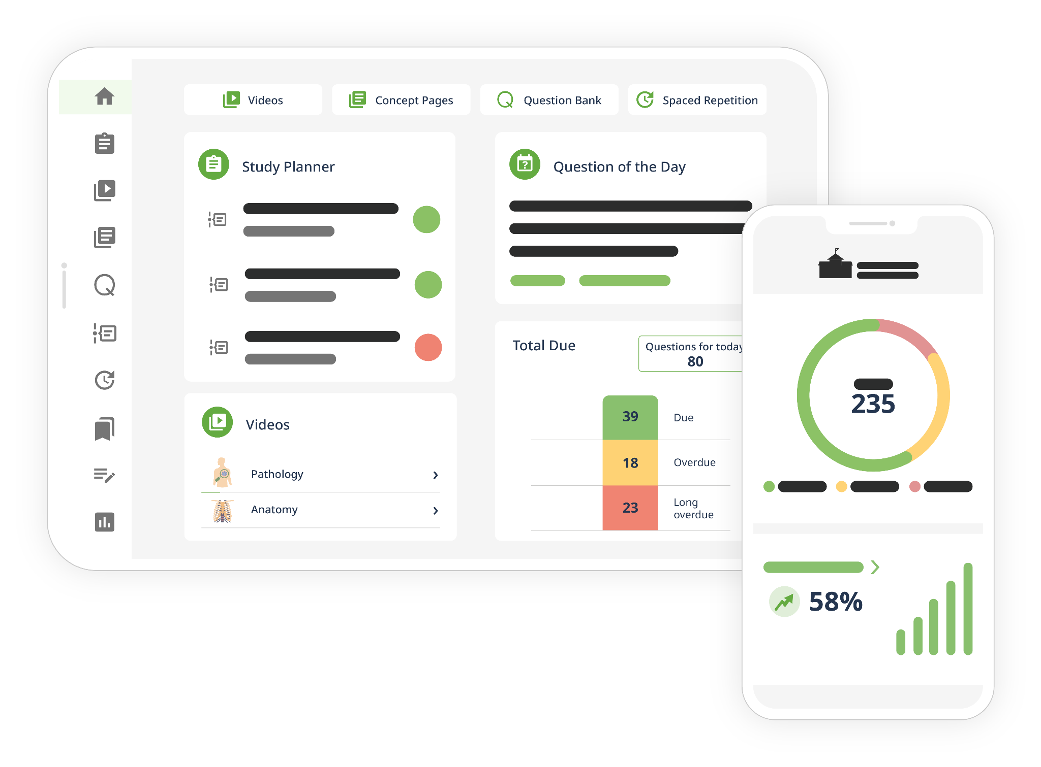
Lecturio
comprehensive digital medical education platform
Content from top professors including from

Slide 7
Medical & Nursing
Lecturio Covers the Entire
Curricula in all key learning formats
12,000+ High-End Videos
in TV quality, short, and engaging
9,800+ Clinical Cases
with text and video explanations
35,000+ Recall Questions
using a spaced repetition
algorithm and adaptive review
1,500+ Concept Pages
organized in a comprehensive library

Slide 8
Concise Videos on All Key Concepts
All key medical concepts are covered in-depth
3-9 minutes
Linked recall questions for formative assessment

Slide 9
3D Anatomy With 400 Pre-Mapped Views

Slide 10
Comprehensive Coverage of Clinical Skills

Slide 11
Comprehensive Coverage of Clinical Skills

Slide 12
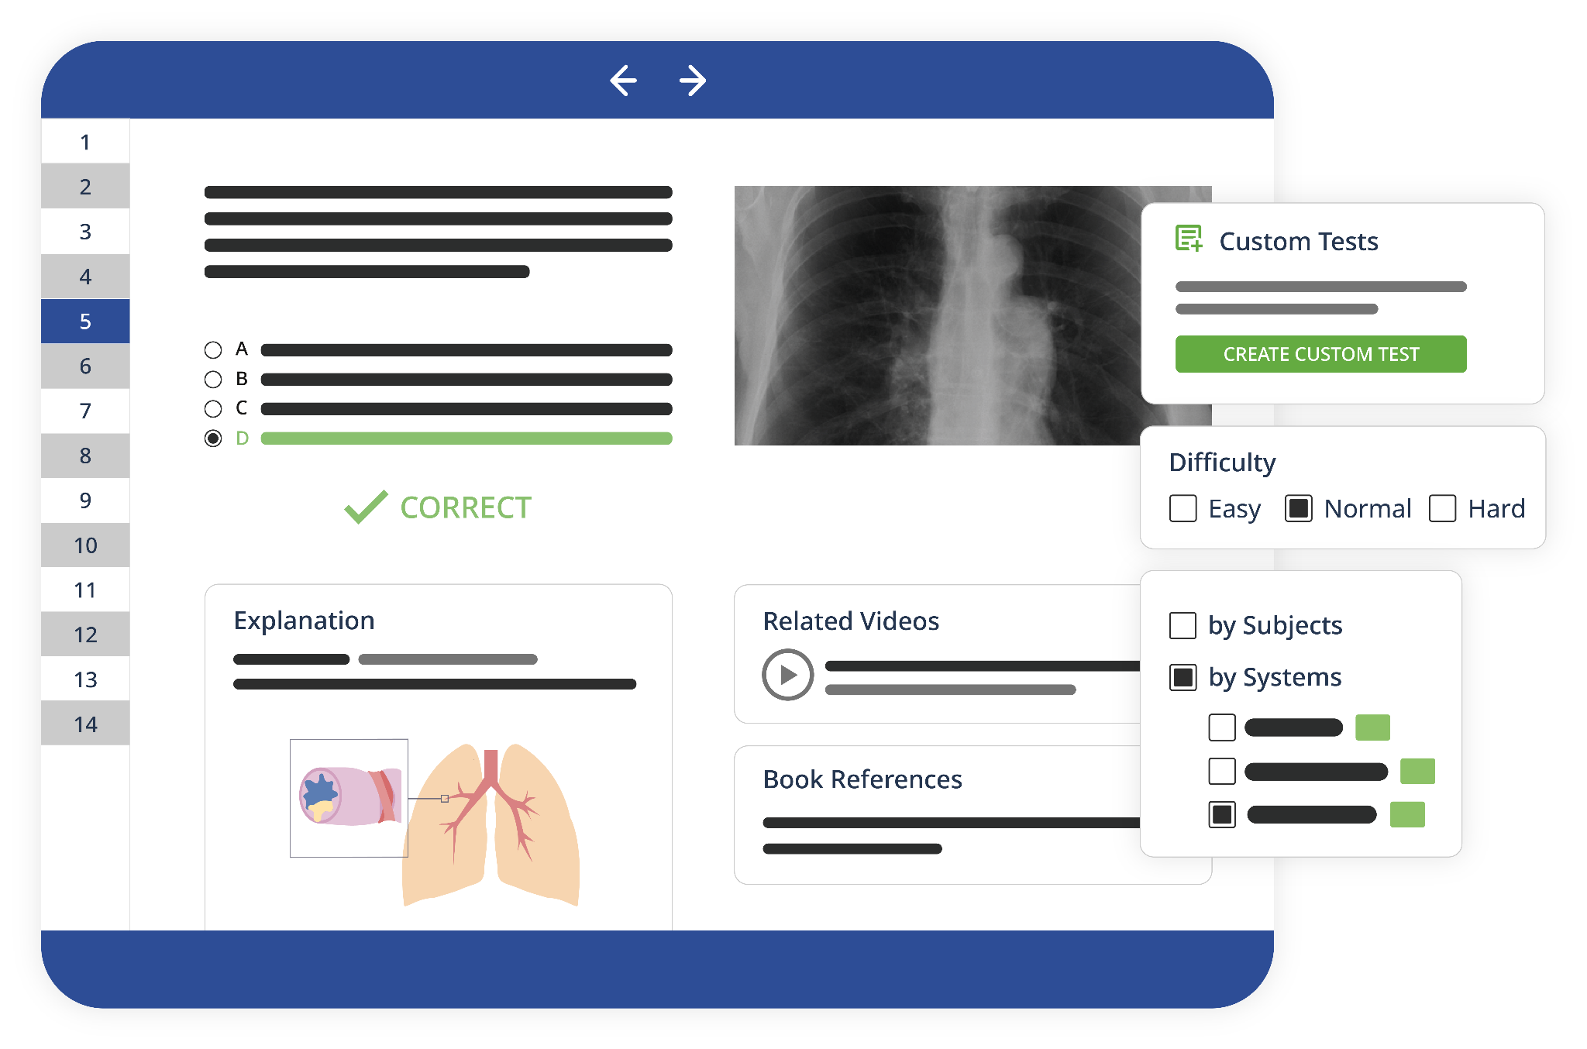
Clinical Cases to Practice Application of Learned Concepts
Real-life clinical scenarios
Automated feedback
Linked videos
Use for self-directed learning or exams

Slide 13
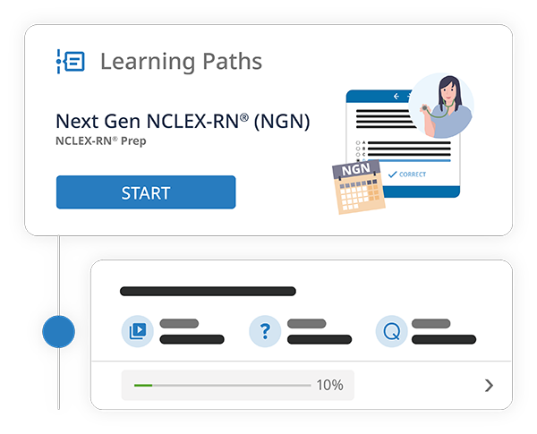
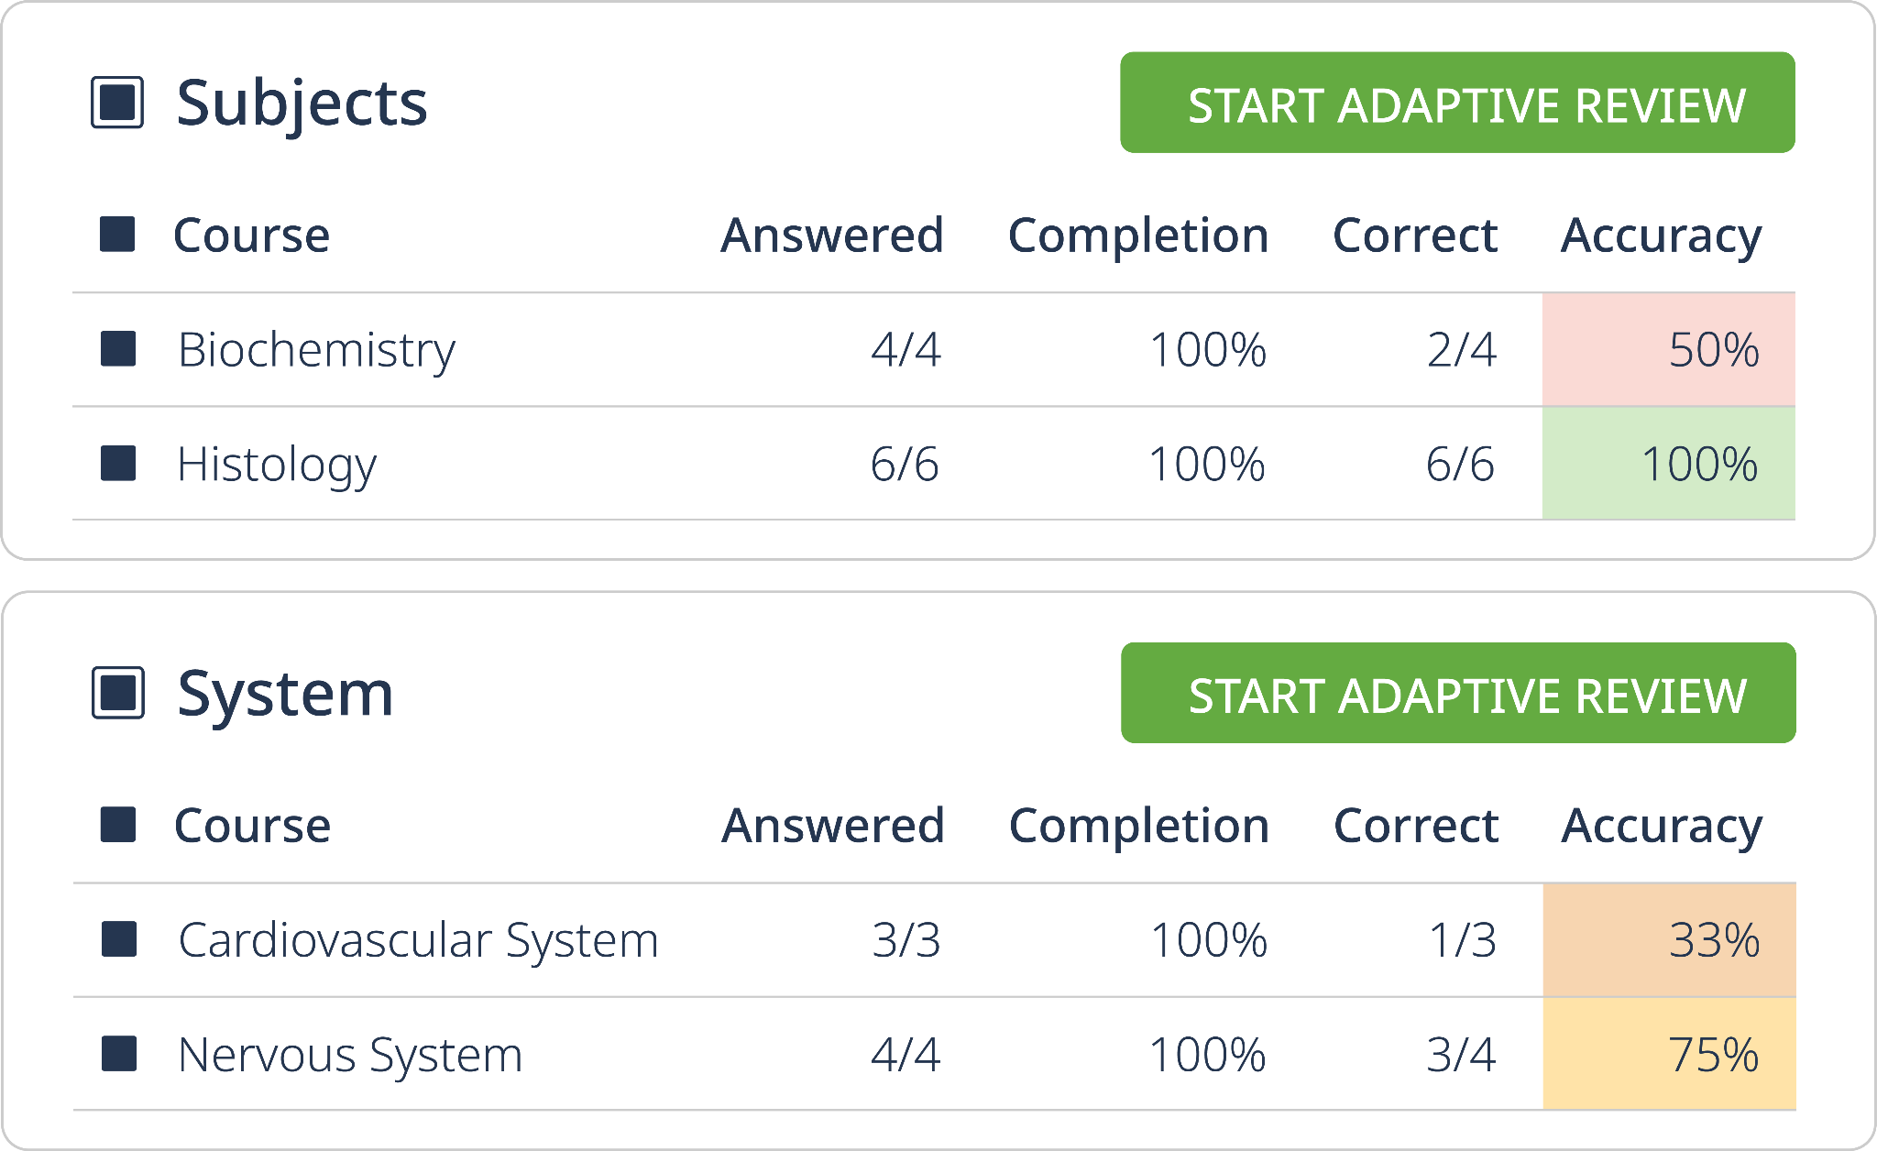
Detailed Learning Paths
for USMLE® Step 1, 2, NBME Subject Exams, NP, NGN & More
Learning Paths combine video and Qbank blocks
Adaptive review within each path

Slide 14
Lecturio Concept Pages
The fastest and easiest way to find and fill knowledge gaps

Slide 15
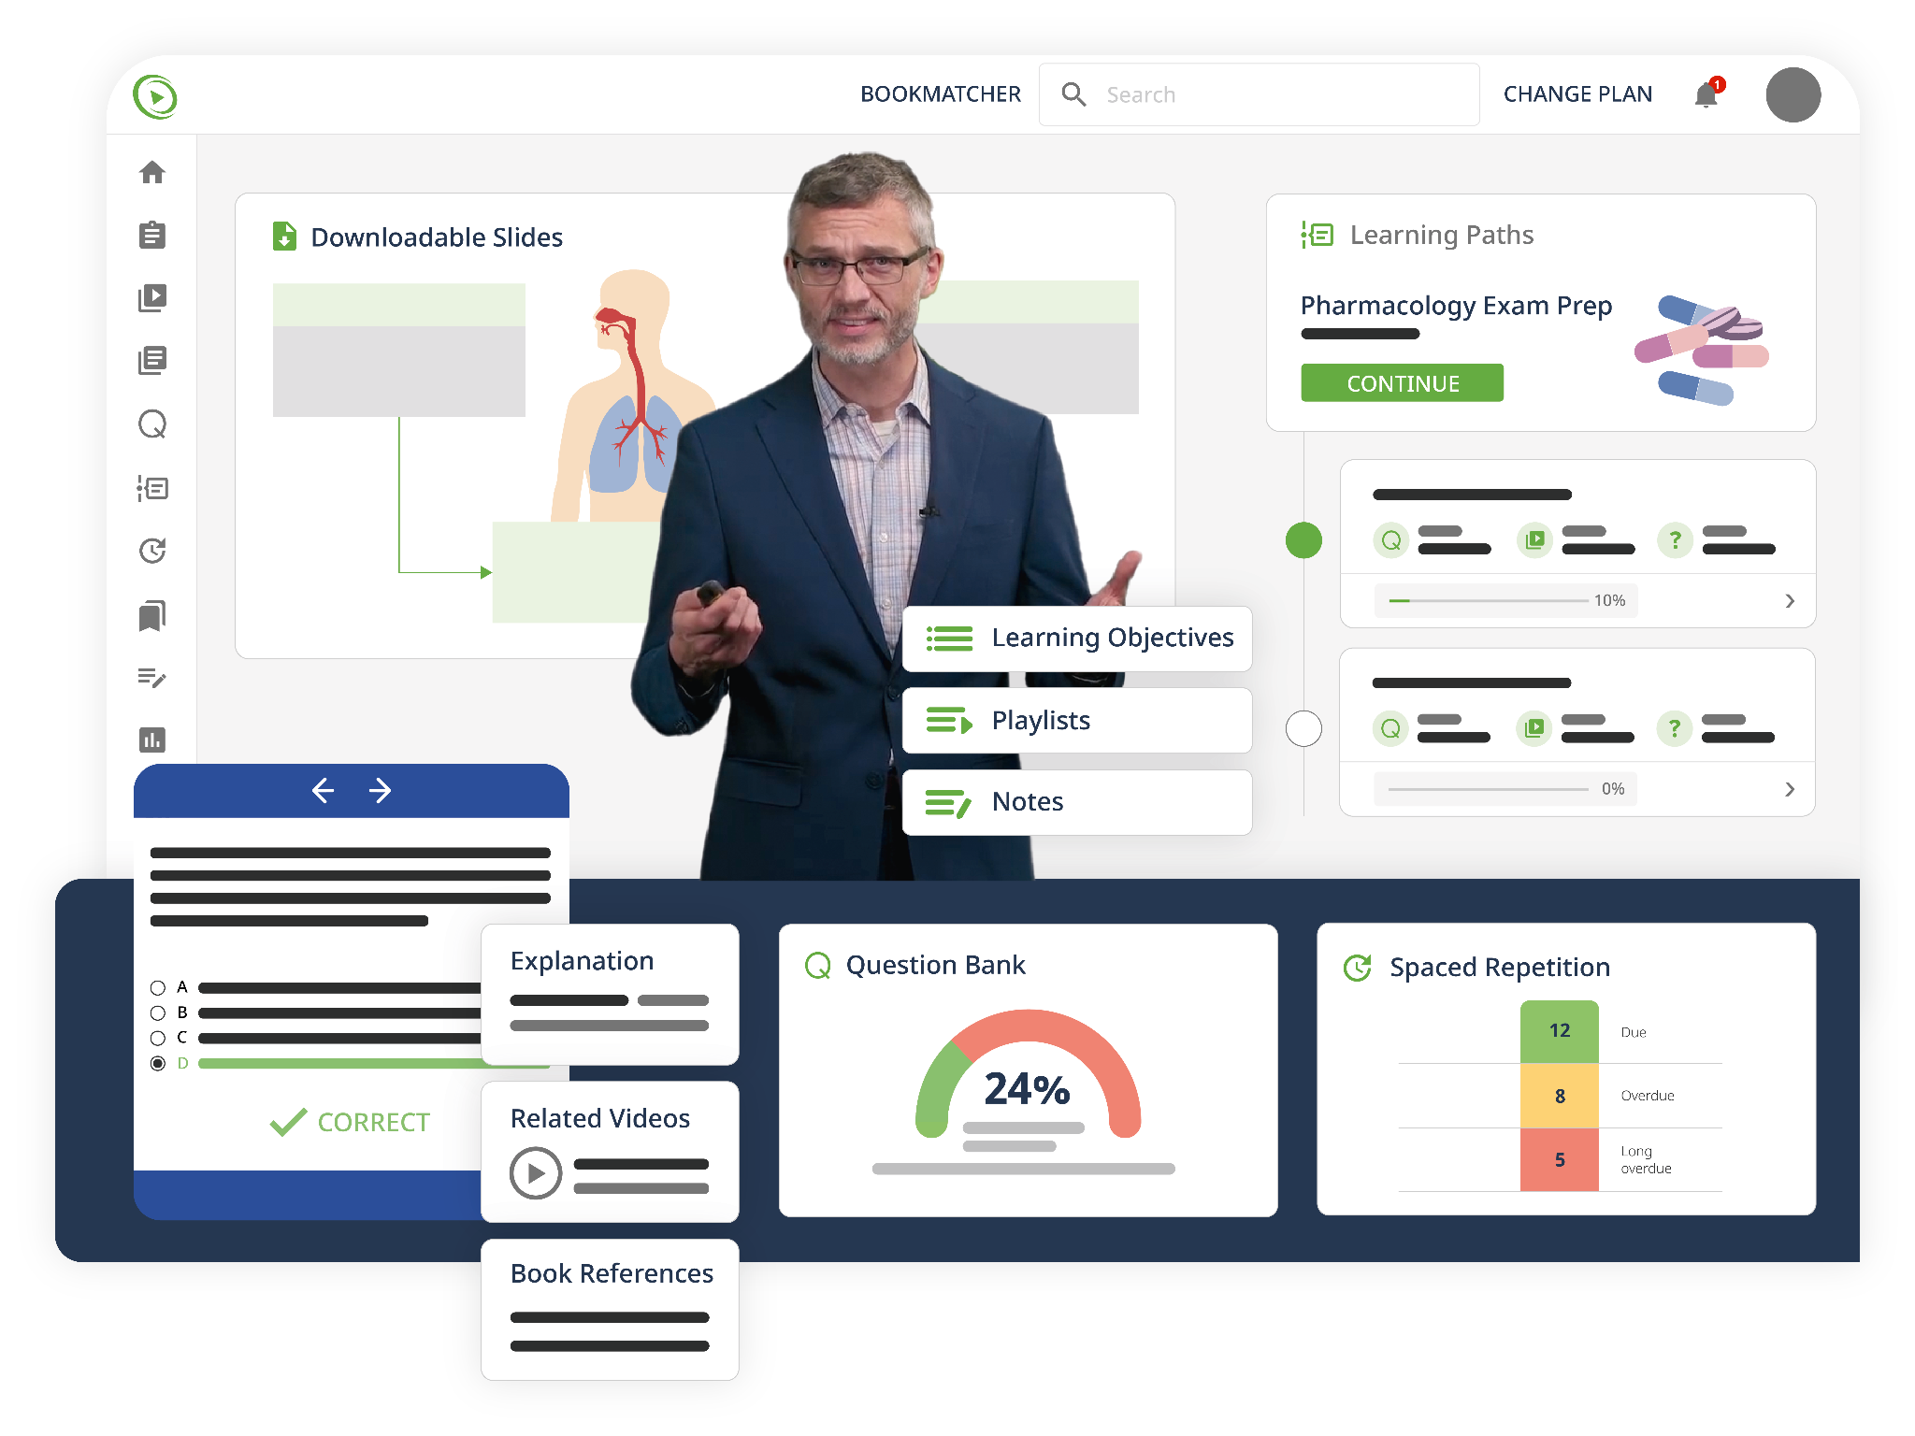
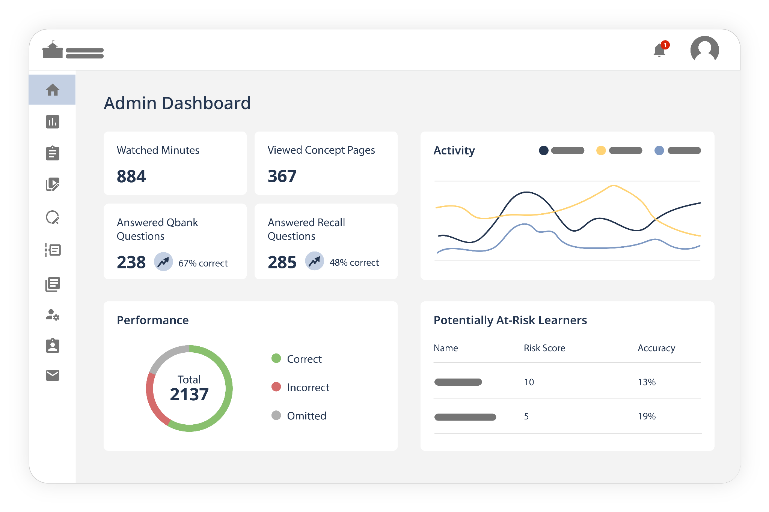
Precision Health Science Teaching
The Two Sides of
For Students
For Faculty
Personalized smart tutor
Digital teaching assistant

Slide 16
Instructional Design

Slide 17
What is instructional design?
Creating content
Instructional Design
Designing courses
Building assessments
Notes:
Instructional design prescribes actions to optimize learning outcomes and links learning theory to educational practice(1). While instructional design includes actions familiar to educators such as creation of content and assessments, the systematic design of instruction entails all steps necessary to ensure development of high quality learning experiences from identifying the need for instruction to the final stage of evaluating whether the desired learning occurred.

Slide 18
What is instructional design?
Prescribes actions to optimize learning outcomes¹
Instructional Design
Links learning theory to educational practice¹
Considers every aspect of the teaching and learning process
Reigeluth CM. Instructional Design Theories and Models: An Overview of Their Current Status. Routledge; 1983. 494 p.
Notes:
Instructional design prescribes actions to optimize learning outcomes and links learning theory to educational practice(1). While instructional design includes actions familiar to educators such as creation of content and assessments, the systematic design of instruction entails all steps necessary to ensure development of high quality learning experiences from identifying the need for instruction to the final stage of evaluating whether the desired learning occurred.

Slide 19
Instructional Design
Notes:
Instructional design is systematic, where the pieces are interrelated, cohesive, and outcome-based to ensure the alignment of essential learning elements. Systematic instructional design considers every aspect of the teaching and learning process. It includes examining goals, the learners’ needs and abilities, the environment for learning, the resources available, and desired performance in order to develop the assessments, the instructional strategy, and the necessary materials.

Slide 20
What is the importance of instructional design?
Instructional design helps make learning more effective, efficient, and engaging.
Instructional design helps ensure alignment
Instructional design provides a proven framework for evidence-based instruction.
Notes:
As an educator, you probably hear many great ideas but wonder how to incorporate them into your already packed course. You may also wonder how to determine when and where to revise your course. Instructional design helps by creating learning experiences that are effective, efficient, and engaging. One way instructional design can do this is by ensuring alignment among course components. Instructional design also provides a framework to incorporate evidence-based educational practices like the ones we will see throughout these professional development lessons.

Slide 21
Instructional Design
Models

Slide 22
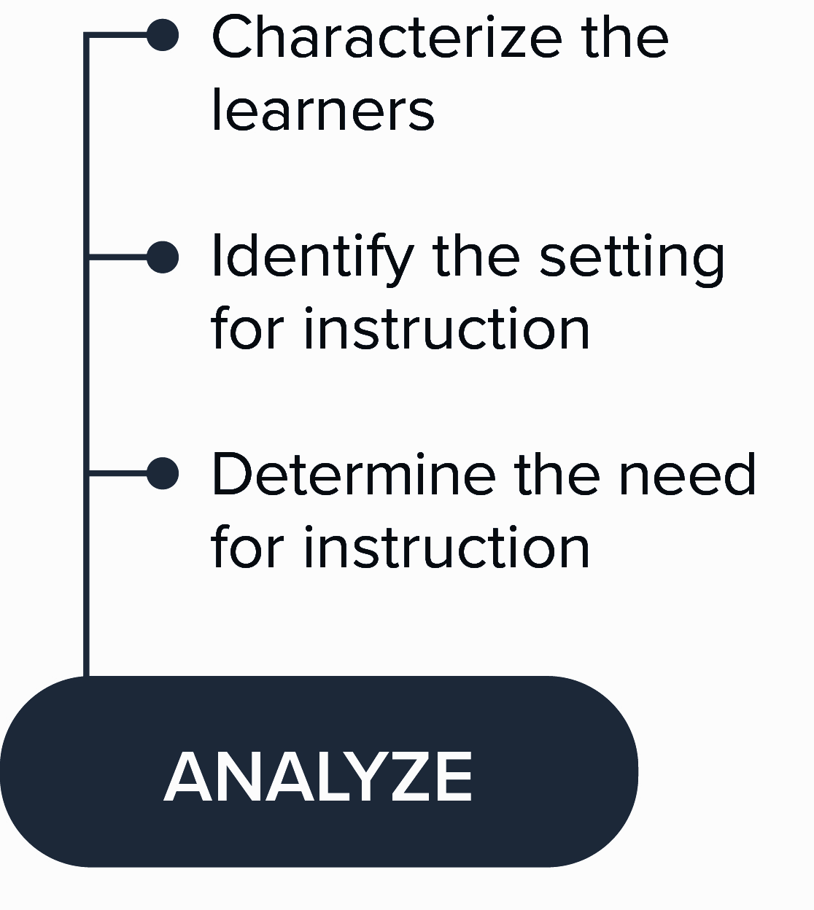
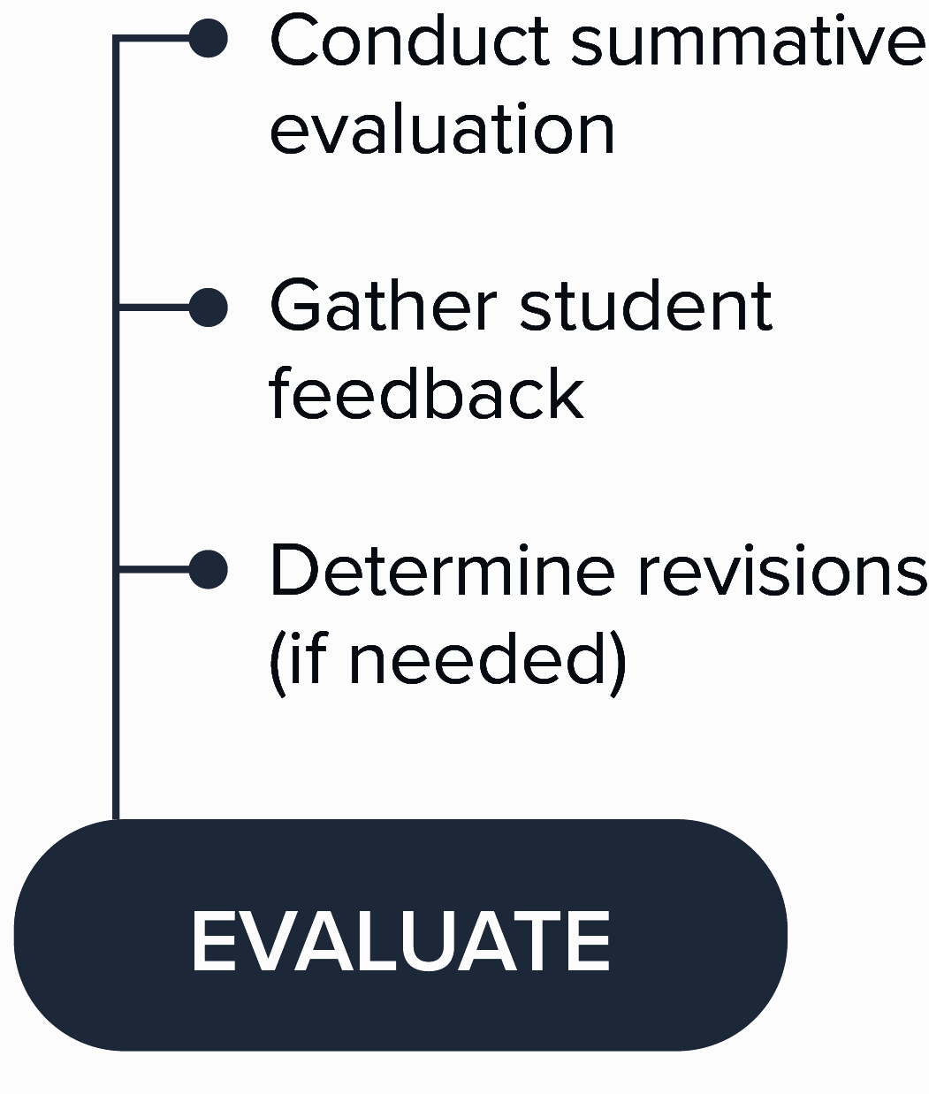
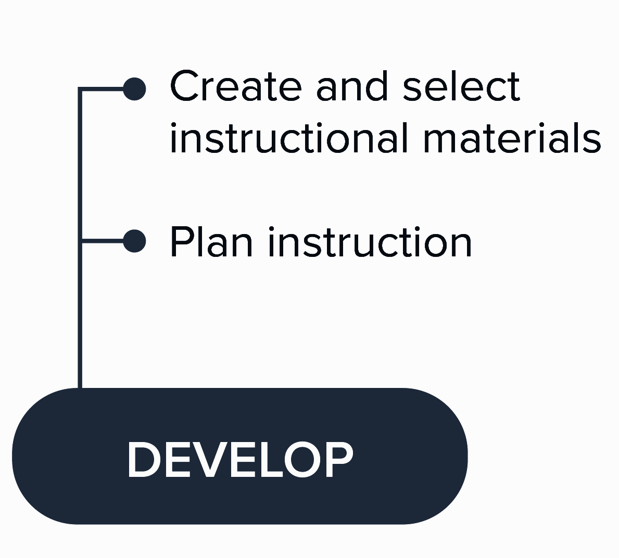
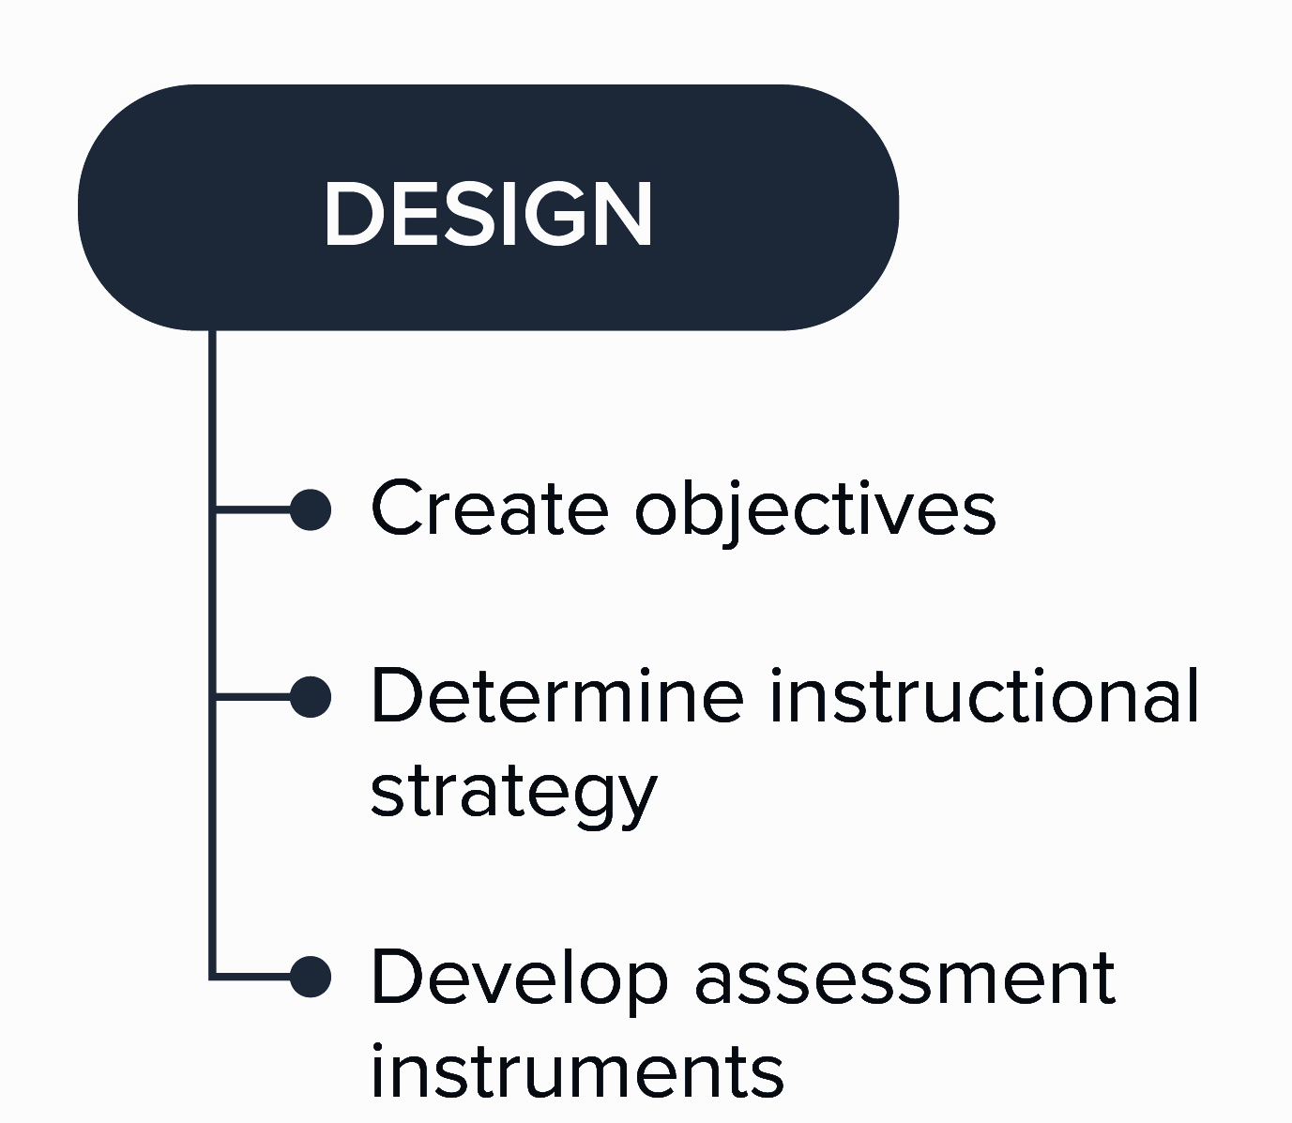
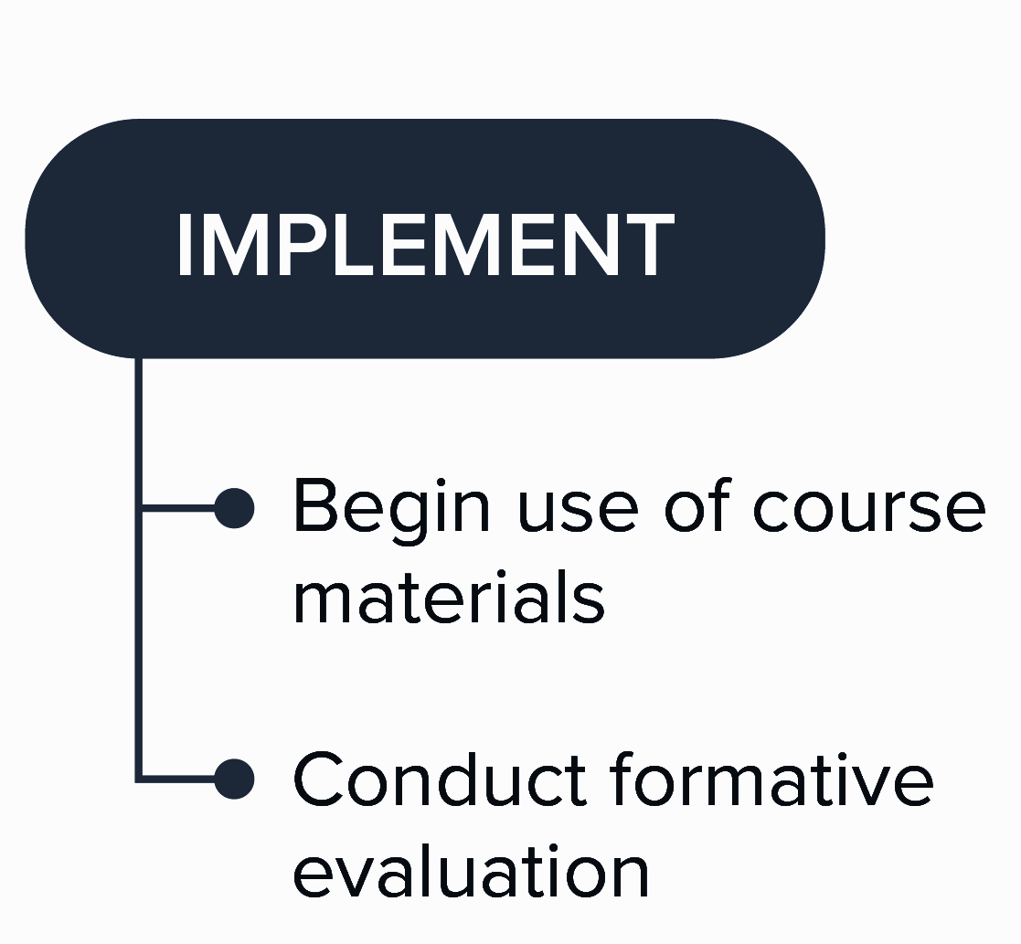
Instructional Design Models
Linear Model: ADDIE
Notes:
The Addie Model has been the foundation for many instructional design approaches for years

Slide 23
Instructional Design Models
Agile Model: Successive Approximation Model (SAM)²
2. Allen MW, Sites R. Leaving ADDIE for SAM: An Agile Model for Developing the Best Learning Experiences. American Society for Training and Development; 2012. 216 p.
Notes:
Agile approach, not linear
Allows for rapid prototyping, but may need numerous revisions
Needs collaboration with stakeholders
Preferred with time-sensitive needs

Slide 24
Instructional Design Models
AVIDesign Model³
3. Hirumi A. IAMSE 2021—Plenary Session: Top 10 Ways an Instructional Designer Can Help You Define the New Normal. Med Sci Educ [Internet]. 2021 Sep 17 [cited 2022 Apr 15];31(Suppl 1):9–16. Available from: https://www.ncbi.nlm.nih.gov/pmc/articles/PMC8448173/
Notes:
Agile evidence based model
Start by articulating needs, defining outcomes and discussion options
Ask LICO (learner) - get evidence and appraise
Apply evidence, develop resources
formative/summative assessments

Slide 25
Instructional Design Models
Other Models

Slide 26
Instructional Design
Benefits

Slide 27
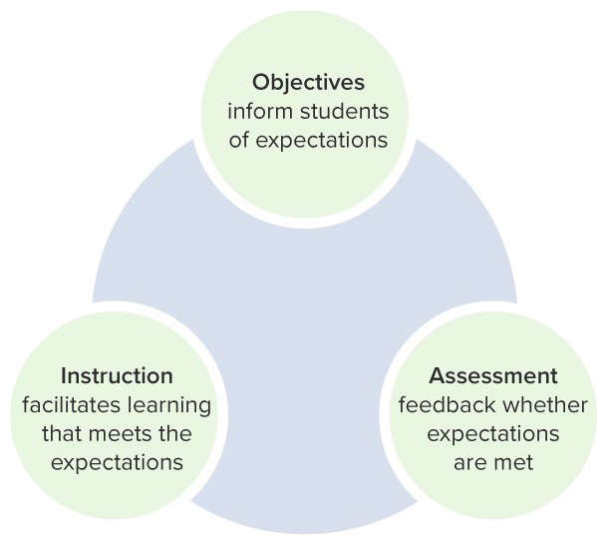
1
Alignment
The Golden Triangle: Alignment of objectives, assessment, and instruction
Notes:
Makes it clear for students what is expected “good to know” vs “need to know”
Less frustration with assessments
Better performance on assessments
Better learning

Slide 28
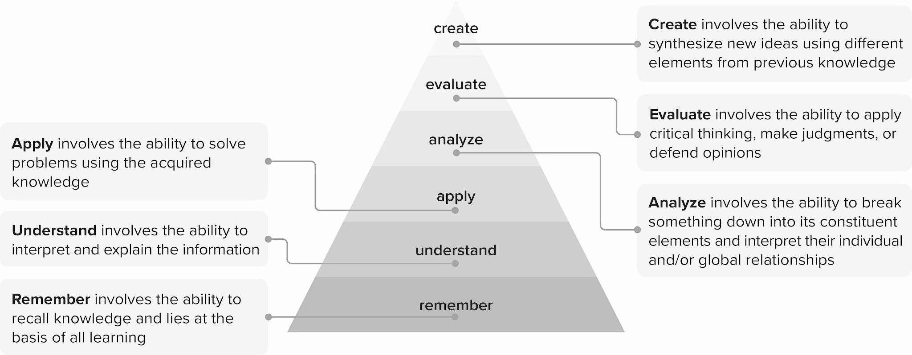
Objectives
Assessment
Instruction
1
Alignment
Bloom’s Revised Taxonomy
Notes:
Instructional design typically prescribes the development of objectives to help inform methods of assessment to then determine instruction and content. This alignment is often driven by the wording of the objectives, in particular the use of verbs such as those found in Bloom’s revised taxonomy. For example, if an objective requires students to identify a disease, the assessment should also be at the “remembering” level, asking students for basic recall of the related facts. Misalignment may occur if the students are then assessed on their ability to compare and contrast with another diseased state (which would be at the analyze level) or determine a treatment plan (which is at the create), unless those were given objectives in the same lesson.

Slide 29
Evidence
Evidence-Based Education
Quality of Instruction
2
Quality of Instruction
Relating to learning outcomes
Effective
Efficient
Relating to learning theories
Engaging
Relating to instructional approach or delivery
Notes:
Another benefit of instructional design is helping to create quality instruction. The use of evidence-based educational interventions helps ensure that instruction is effective, efficient, and engaging. Most instructional design models also incorporate revisions which continue to improve instruction even after it is implemented.
High quality instructional materials can take extensive time to develop but by targeting curricular needs and student needs, instruction can be developed and delivered more efficiently than by trial and error. The use of evidence-based educational practices helps ensure the quality of the learning materials and experience. Effective educational design is dependent on practice grounded in empirical evidence rather than the use of fads, anecdotes, and flawed research(10). Evidence may relate to learning outcomes, such as how to teach students to interpret EKGs, or it may relate to learning theories that tell us how people learn, such as learning sciences that prescribe using spaced repetition, or it may relate to instructional approach or delivery, such as case-based learning. The use of evidence to create evidence-based education helps ensure the quality of instruction that is effective, efficient, and engaging.

Slide 30
2
Quality of Instruction
Notes:
Recall from our previous lesson, the final stage of most instructional design models have a final step of evaluation including revision, if necessary. This is done by evaluating instruction after it has been implemented. As instructors, we may naturally make adjustments when we feel instruction isn’t working or the students just aren’t “getting it”, but this can be augmented by a more systematic approach - gathering student feedback, comparing results to desired standards, and gathering more evidence that may apply. Educators may even consider planning research around this process to share the results.

Slide 31
Resources and materials are transferable between skilled instructors.
Courses do not need to be recreated every time they are taught.
Developing one high quality module or course can help inform the development of future similar modules or courses.
3
Replicability
Notes:
When faculty design courses and materials, they often rely on their own experience to fill in the gaps in curricular resources. It may be difficult for someone else to step in to teach the class for a day, a week, or a semester in the same manner as the original instructor. If the course is passed to another instructor, they must redevelop the entire course with very few materials, perhaps based only on some objectives and a text that was used before. However, instructional design makes all steps of instruction explicit and replicable(7). A course should be transferable in its entirety to another skilled instructor. Similarly, the development of materials can be used as a template for other similar courses or modules. For example, if a module is developed for one course based on its learners and resources (e.g. learning management system and available texts, videos and question banks), other modules in that course or similar courses within the program could be developed using the same strategy and design with step-wise modifications to the objectives, content, and assessments.

Slide 32
Time Savings with Lecturio
within the Instructional Design Process
Notes:
We want to optimize instruction and support you with your learners. So what have we done?

Slide 33
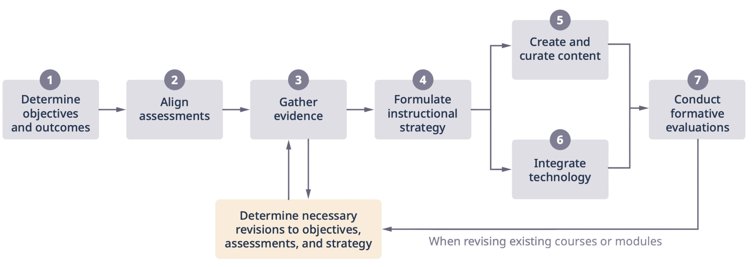
Instructional Design Outline
Developing a new course

Slide 34
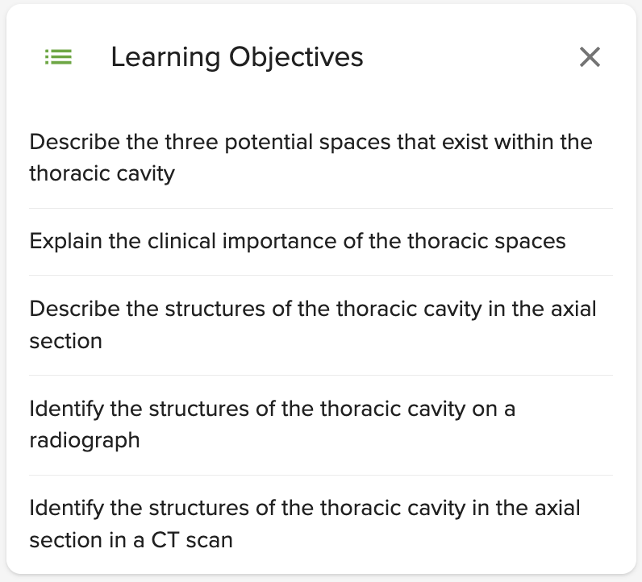
Time Saving Feature
Video Lecture Objectives
1
Determine objectives and outcomes
Preset objectives that can help inspire or support educators in determining or matching lesson objectives with assignments through Lecturio

Slide 35
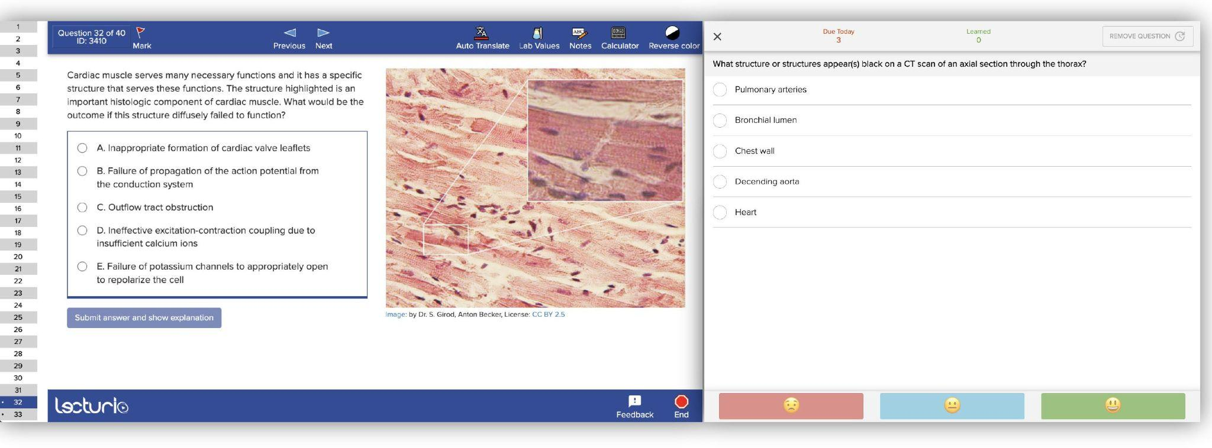
Time Saving Feature
Qbank & Quiz Questions
2
Align Assessments
Qbank and Quiz Questions repository can act as springboard for educators to align assessments from. Pre-mapped Qbank helps take burden off of educators.
Notes:
Our massive library of questions in our Qbank and Quiz question repository can help provide a springboard for educators to align assessments from. With our pre-mapped Qbank, we take the burden off the educator to make matching the assessment with the objectives simple.

Slide 36
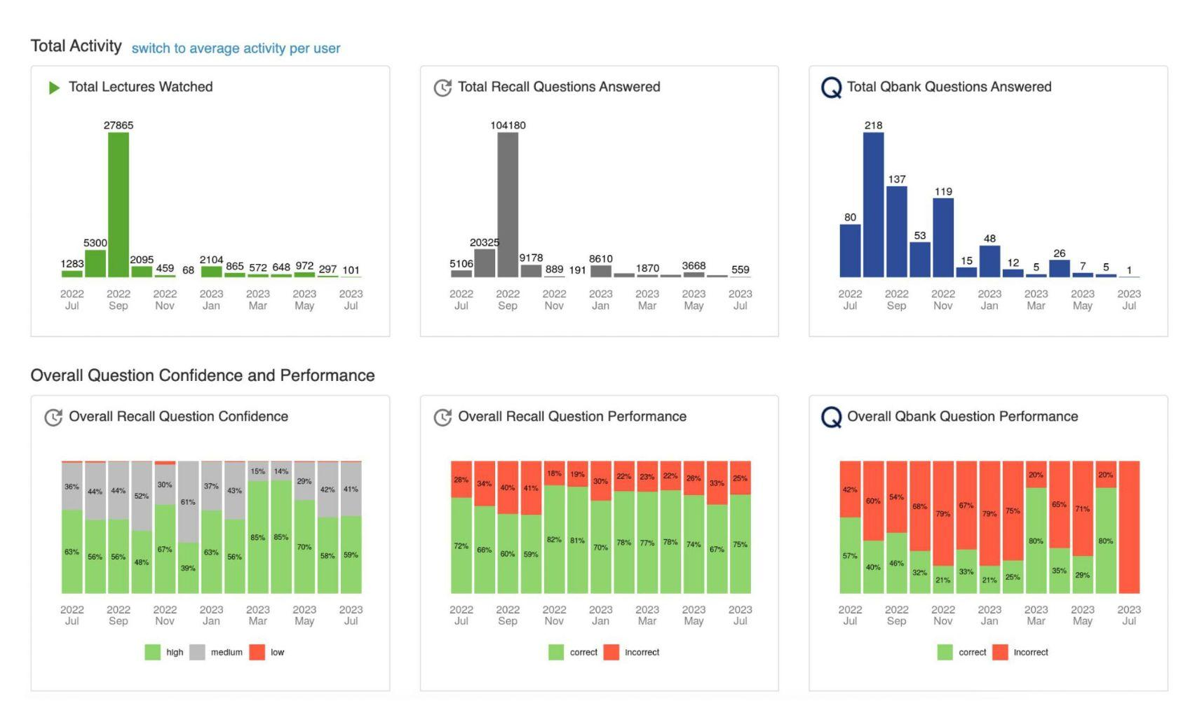
Time Saving Feature
Learning Analytics
3
Gather Evidence
The Learning Analytics data in Lecturio can show where students need work, what questions they find difficult, and what objectives they have already covered. (etc etc)
Notes:
Gather Evidence based on learners, instruction, and outcomes

Slide 37
Time Saving Feature
Faculty Development
4
Formulate Instructional Strategies
The Lecturio webinars and faculty development workshops can help educators stay up to date on the latest instructional strategies and teaching approaches.
Notes:
Formulate Instrucitonal Strategies: Our learning webinars and faculty development workshops can help educators stay up to date on the latest instructional strategies and teaching approaches that they can use for different kinds of learners, adding to their existing expertise.

Slide 38
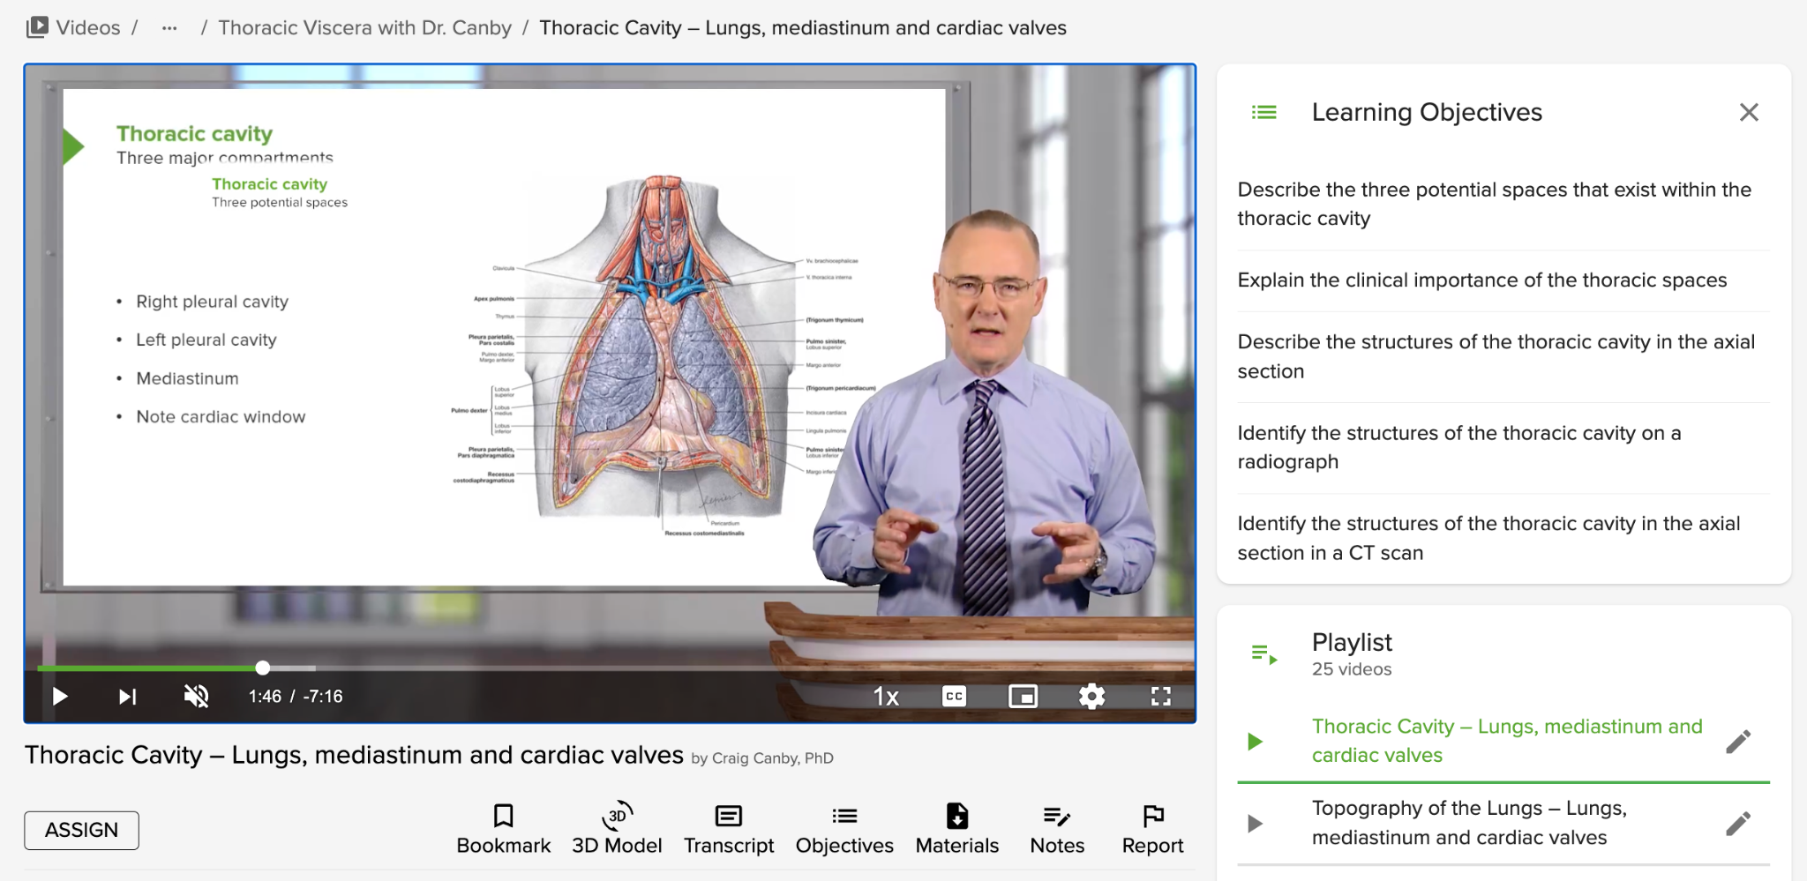
Time Saving Feature
Video library
5
Create and Curate Content
Our video library and concept notes provide a ready-to-use repository of content, making this step much faster.
Notes:
Create and Curate Content:
Our video library and concept notes provide a ready-to-use repository of content, making this step much faster. Downloadable slides can also be used and mixed with your own slides, saving the time needed to create and curate content.
Learning paths save time by providing a ready-to-use and aligned lesson-assessment combination, prepared for you and your students by our team of experts.
Lecturio course mapping can take the burden off of educators by curating content into courses that fit your curriculum and plans.

Slide 39
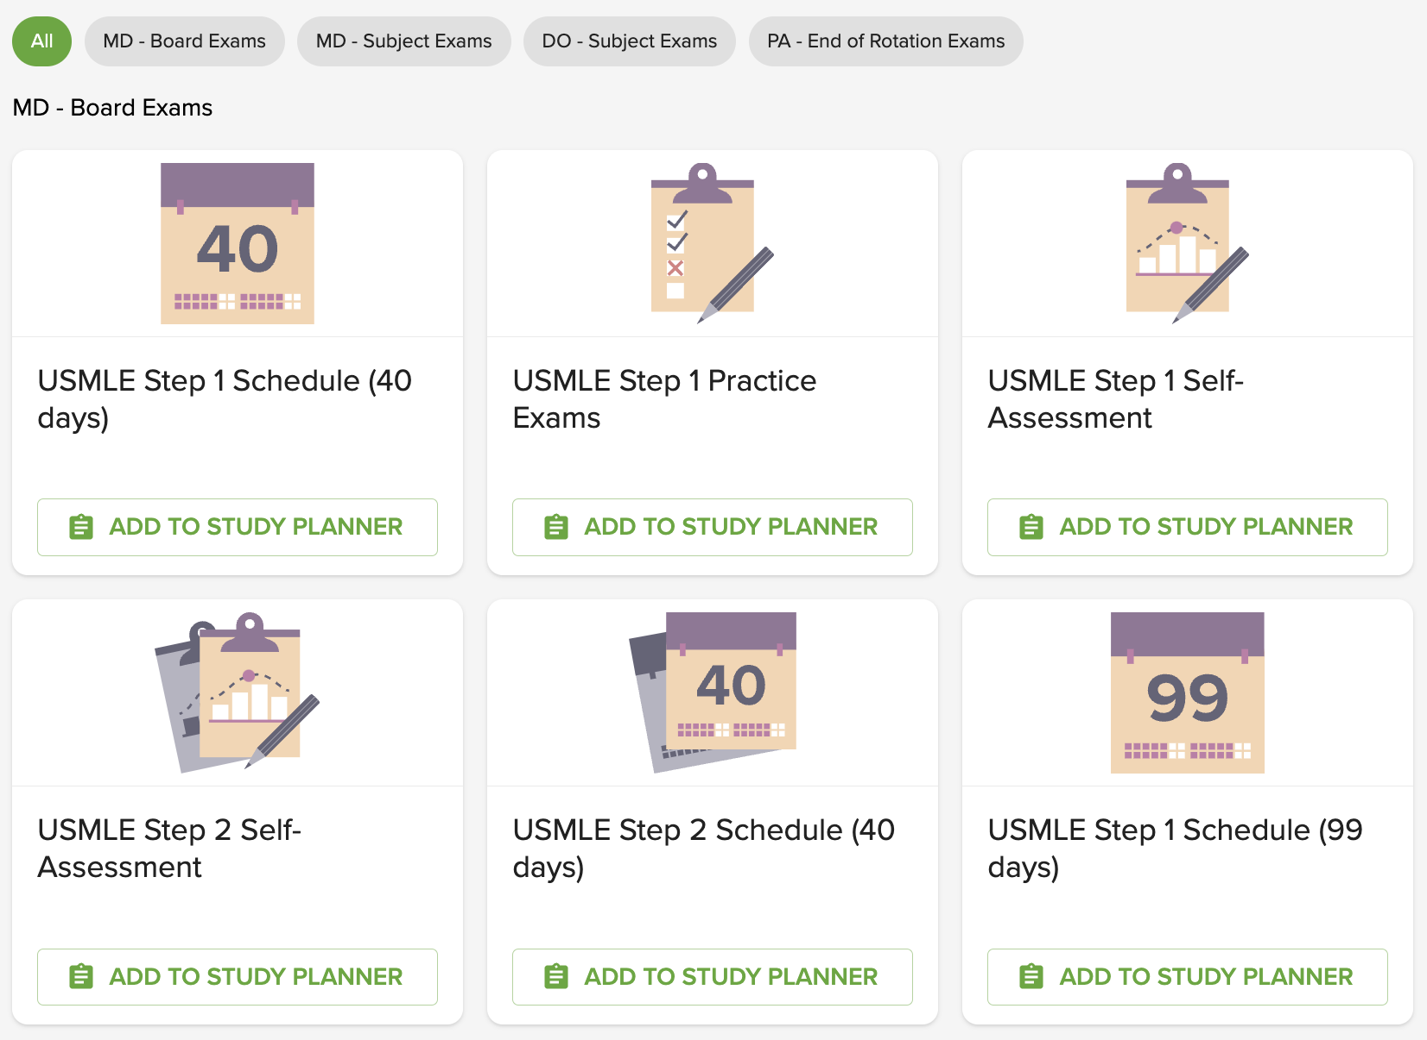
Time Saving Feature
Learning Paths
5
Create and Curate Content
Learning paths save time by providing a ready-to-use and aligned lesson-assessment combination, prepared for you and your students by our team of experts.
Notes:
Create and Curate Content:
Our video library and concept notes provide a ready-to-use repository of content, making this step much faster. Downloadable slides can also be used and mixed with your own slides, saving the time needed to create and curate content.
Learning paths save time by providing a ready-to-use and aligned lesson-assessment combination, prepared for you and your students by our team of experts.
Lecturio course mapping can take the burden off of educators by curating content into courses that fit your curriculum and plans.

Slide 40
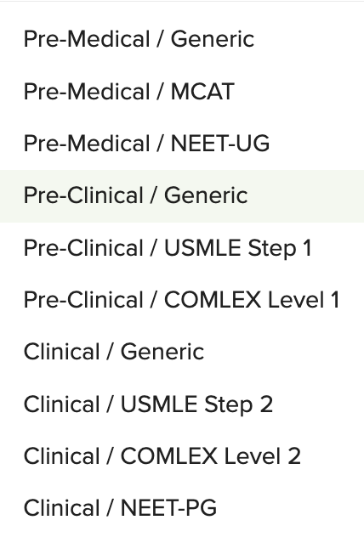
Time Saving Feature
Course Mapping
5
Create and Curate Content
Lecturio course mapping can take the burden off of educators by curating content into courses that fit your curriculum and plans.
Notes:
Create and Curate Content:
Our video library and concept notes provide a ready-to-use repository of content, making this step much faster. Downloadable slides can also be used and mixed with your own slides, saving the time needed to create and curate content.
Learning paths save time by providing a ready-to-use and aligned lesson-assessment combination, prepared for you and your students by our team of experts.
Lecturio course mapping can take the burden off of educators by curating content into courses that fit your curriculum and plans.

Slide 41
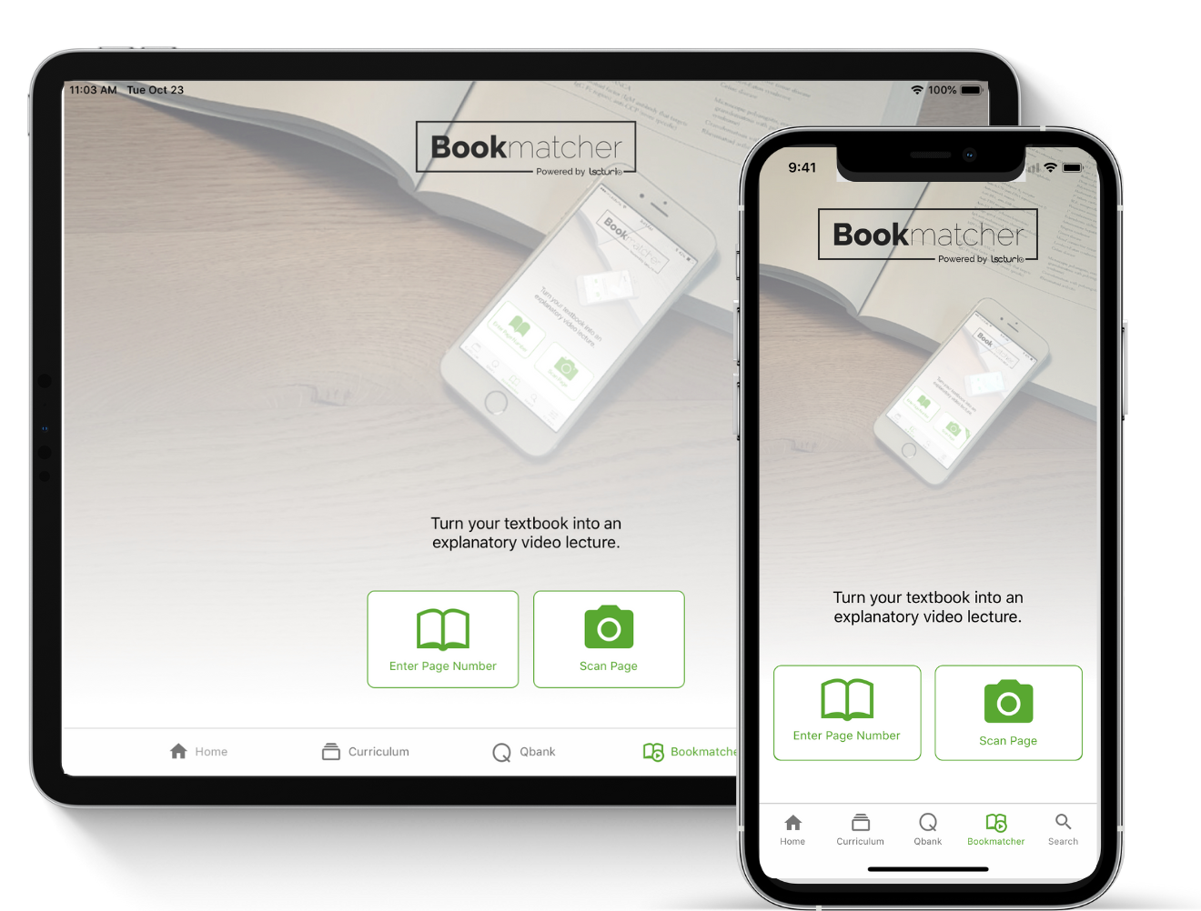
Time Saving Feature
Desktop and App access
6
Integrate Technology
The Lecturio web app and mobile app can be some of the technological tools that teachers include as part of their instructional approach.
Notes:
For example:
Use Lecturio as pre-work and pre-test tool
Provide Lecturio 3D anatomic models as an instructional tool in class.

Slide 42
Time Saving Feature
Evaluation
Formative evaluations can be performed in several ways:
as part of Lecturio’s ready-made learning path
using questions in tutor mode inside the lecturio Qbank
via student performance analysis of their quiz accuracy and Qbank tests.
All of these options allow instructors to save time when designing and conducting formative evaluations, as well as when analyzing their students’ performance, by extension boosting the efficiency and effectiveness of their instructional strategy.
7
Conduct Formative Evaluations
Notes:
For example:
Use Lecturio as pre-work and pre-test tool
Provide Lecturio 3D anatomic models as an instructional tool in class.

Slide 43
Instructional Design Outline
Developing a new course

Slide 44
Other Ways Lecturio can Help

Slide 45
Precision Health Science Teaching
The Two Sides of
For Students
For Faculty
Personalized smart tutor
Digital teaching assistant

Slide 46
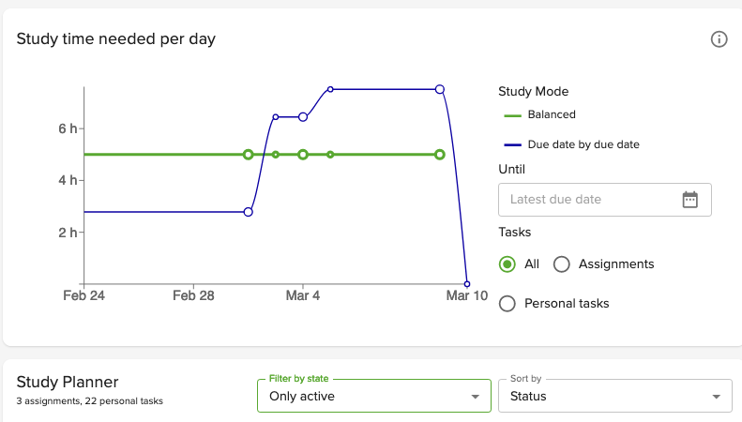
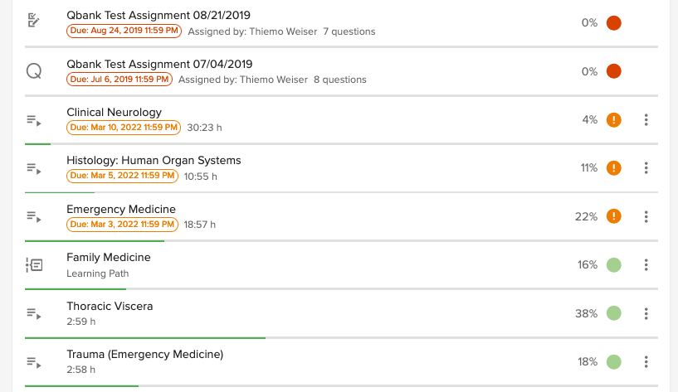
Balanced Study Coach Helps Avoid Study Crunches by Planning Ahead
Notes:
Calculates the required study time per day based on a students' list of self-created or assigned deadlines
Recommends the best activity for the day based on their list of assignments.
The feature helps students manage their time effectively and keeps them on track in reaching their learning goals, no matter how ambitious they may be

Slide 47
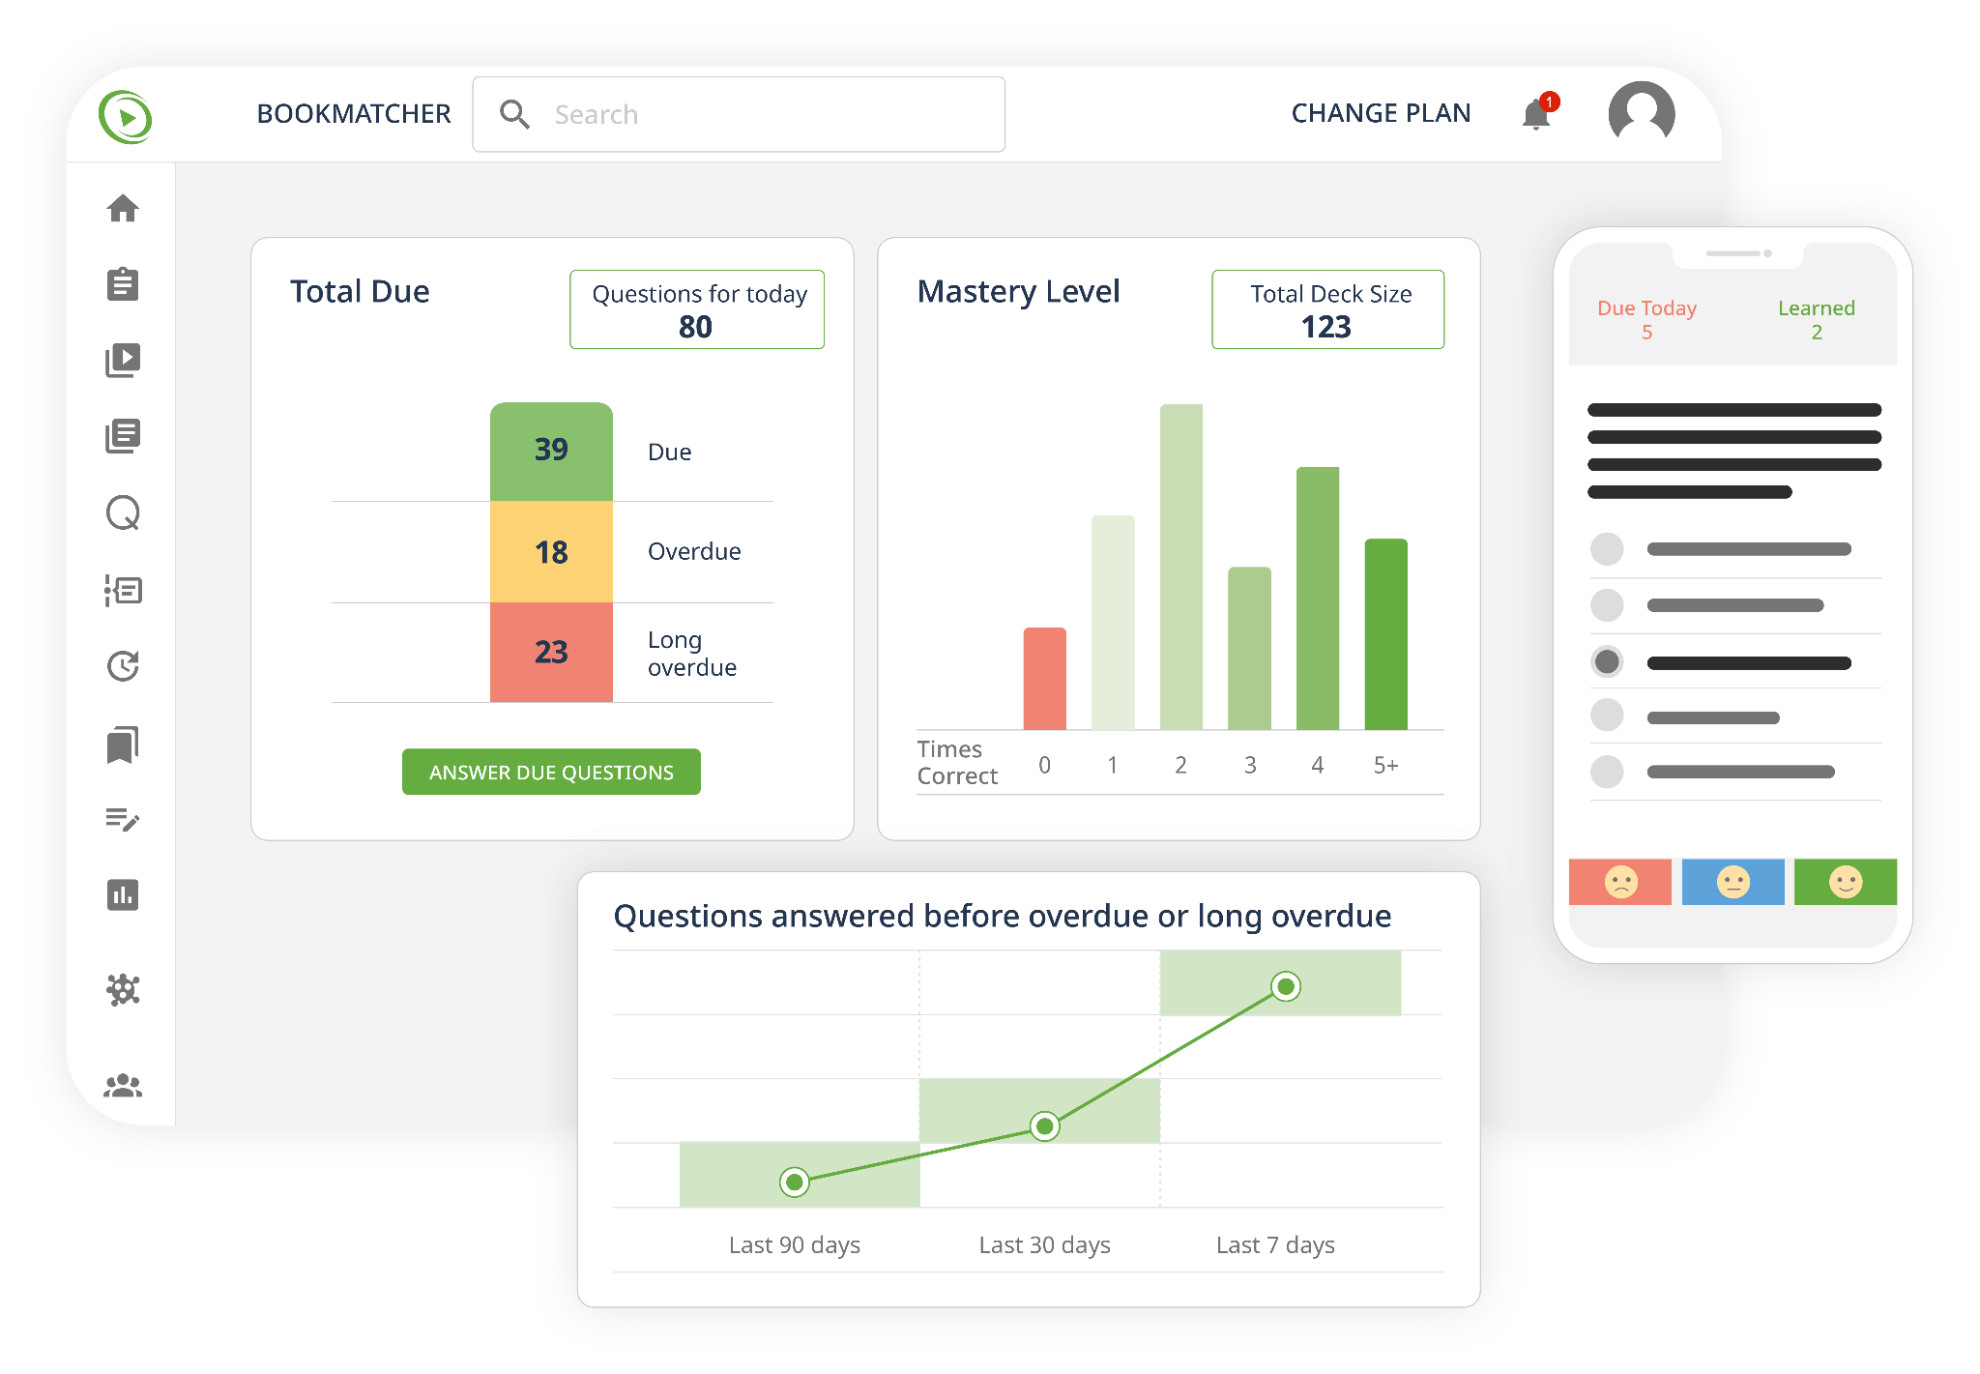
Adaptive Spaced Retrieval Algorithm Drives Long-Term Mastery
Adaptive algorithm improves information recall
Faculty can track / incentivise compliance

Slide 48
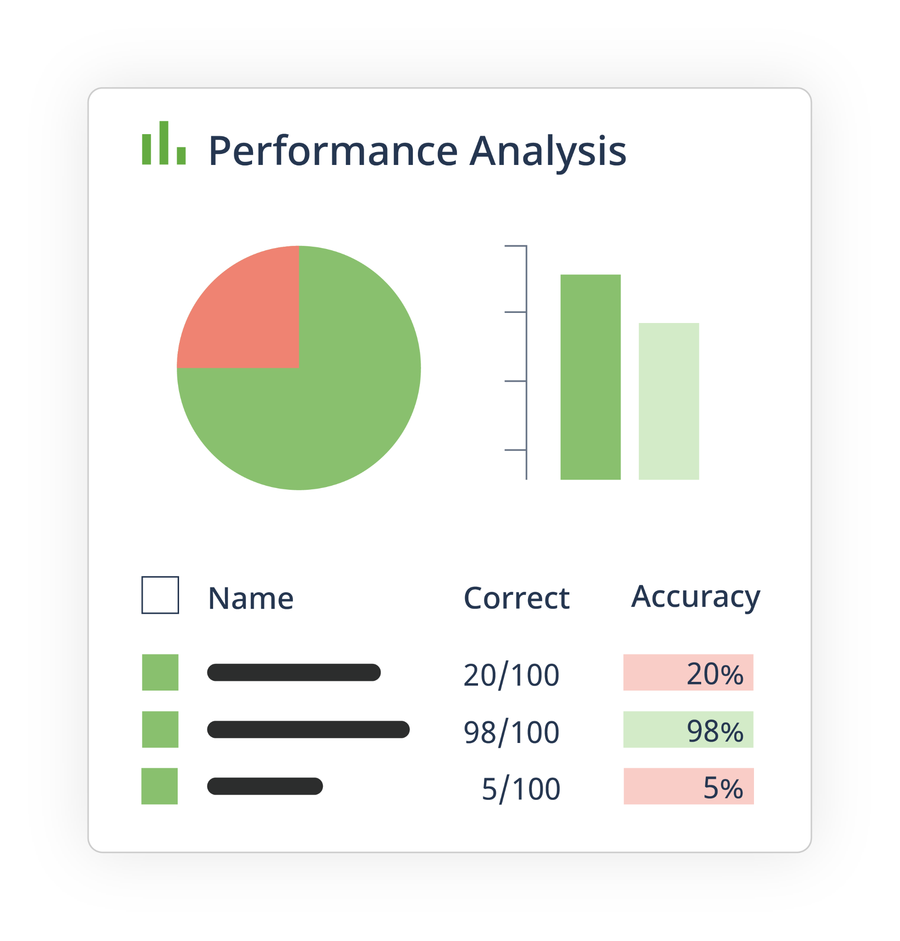
Configurable Adaptive Review Supports Effective Self-Directed Learning
Notes:
Analyzes the performance of a student and create a personalized playlist with videos related to the questions they get wrong.
Learners can immediately see resources to use for remediation to improve their understanding of the concepts.
Students learn what they need to learn when they need to learn it, creating an efficient and individualized learning environment for the student.

Slide 49
Comprehensive Tracking Enables a Comprehensive Live Faculty Dashboard
The system tracks:
competence
confidence
overconfidence
spaced repetition adherence
mastery level
typical mistakes
readiness assessments

Slide 50
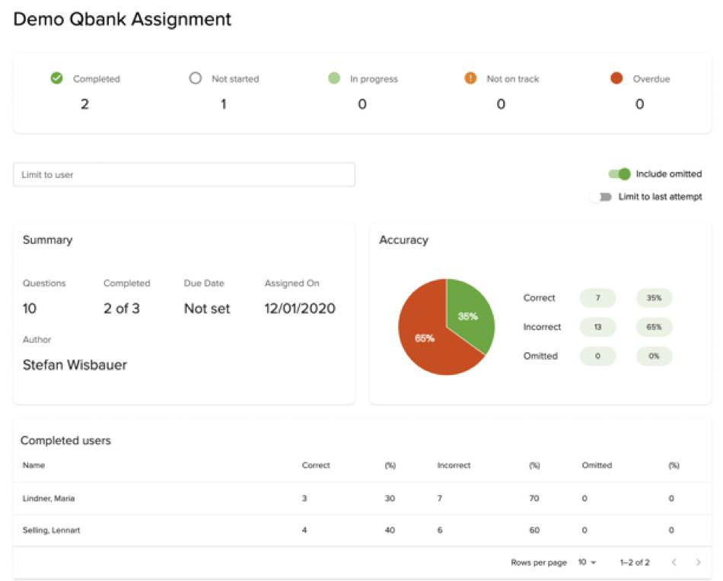
Assignment Stats
Help Focus Teaching Time on Where Students Struggle Including Typical Mistakes

Slide 51
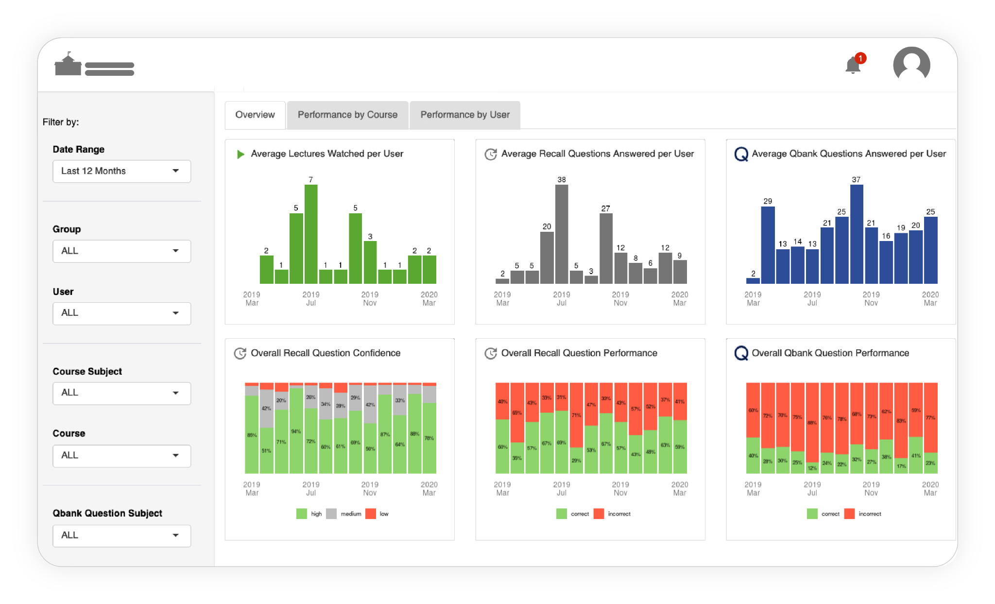
Your Teaching Dashboard
Aggregate Data With Location Drill-Down on Activity, Competence, Confidence, Over-Confidence

Slide 52
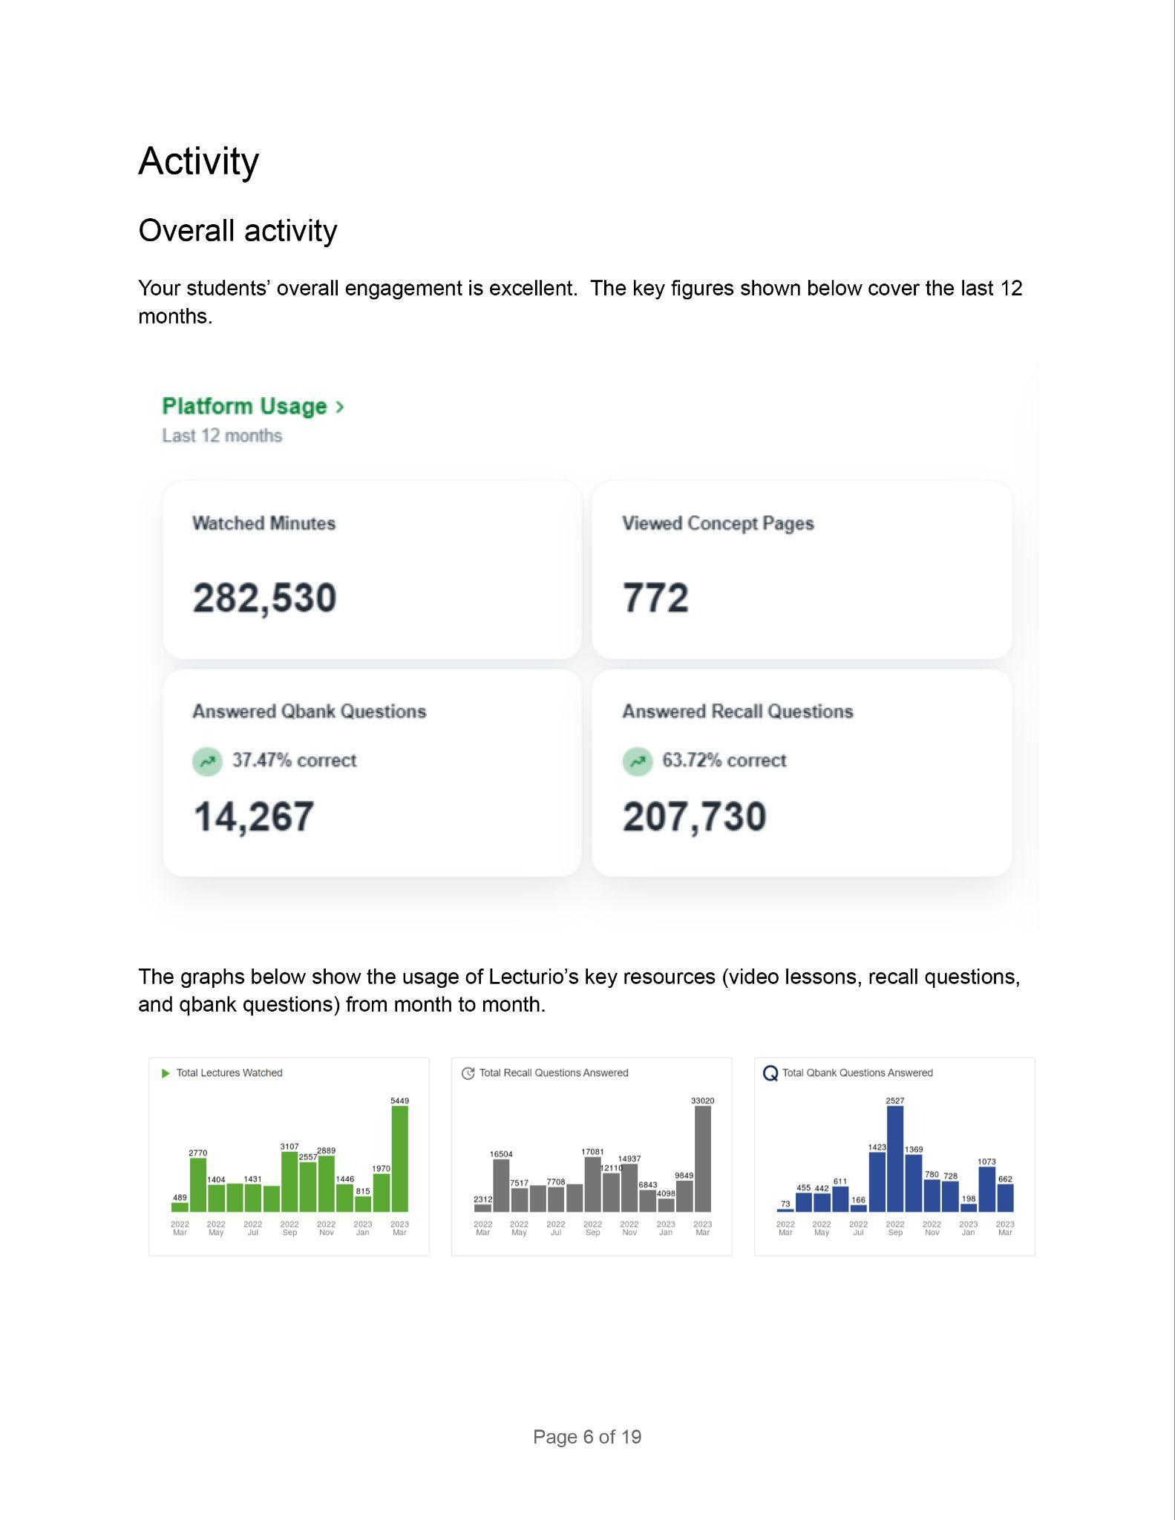
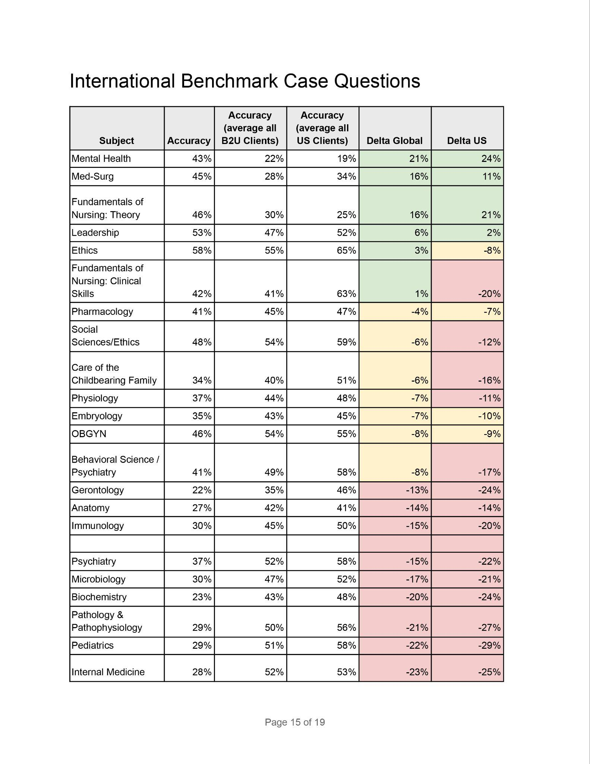
Insight Reports

Slide 53
Easy Integration With Your Existing Setup
LMS / Testing
Live Teaching & Training
Deep Linking
LTI SSO
Session Prep: Strengths & Weaknesses, Typical Mistakes
Proctoring Integrations
Content & Recording Upload
Data Lake / Analytics

Slide 54
Faculty Use Cases
Lecture Preparation
Testing-as-learning assignments
Early High-Risk Identification
Simulation (De)Briefing
In-Class Use (Quiz, Qbank)
Blended Learning
Exam Prep
Faculty Development
Formative Assessment
Flipped Classroom
Remediation Support
Data Analytics Support
Summative Assessment
TBL/PBL support (iRATS, tRATs …)
Clerkship Support
Proctoring (via integration)
Notes:
i

Slide 55
Let’s Teach Evidence-Based Medicine in an Evidence-Based Manner
Request a demo:
institutions@lecturio.com
www.lecturio.com
Notes:
That was all for today. If you would like to know more about the platform or get an in-depth demo please reach out to us.
If you already use Lecturio and want support with isntructional design or anything else, get in touch and our experts would be happy to help.

Slide 56
Durable Learning Seminar
Thank you for joining!
Contact us:
learning-science@lecturio.de

